Slide 1
Credit EDA Assignment
By – SHUBHAM SIDDHARTH

Slide 2
Data cleaning
Before Doing anything we need to make that raw data into operational data.
For that we need to follow some steps according to data set
Which involves many things like , taking null values, extra column, unwanted data and many other things

Slide 3
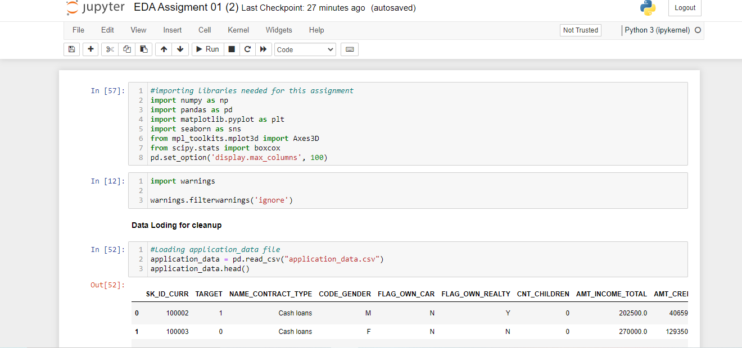
Data cleaning steps
Counting Null Values
Removing Null values
Removing extra columns
Removing unwanted data
Perform analysis then

Slide 4
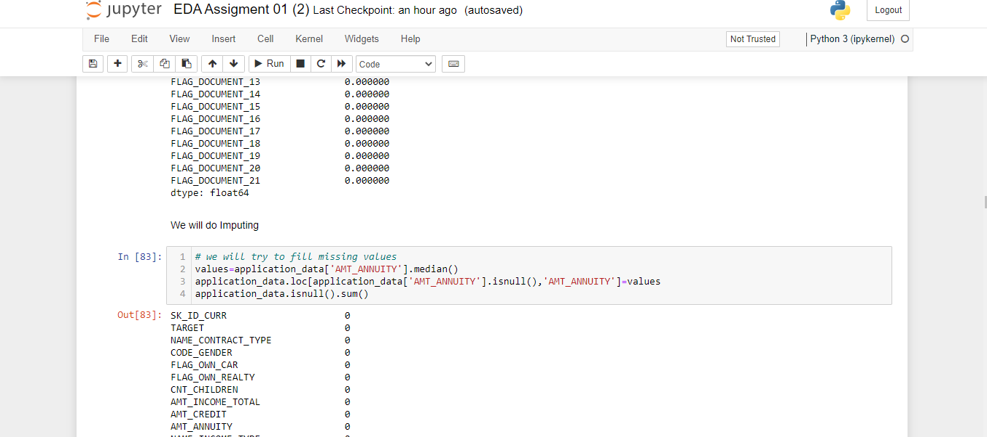
Just couple of more steps mentioning
Identifying the row with less date like les than 30%
Remove all unwanted columns
Rename columns wherever its needed
Start Imputing where its needed

Slide 5
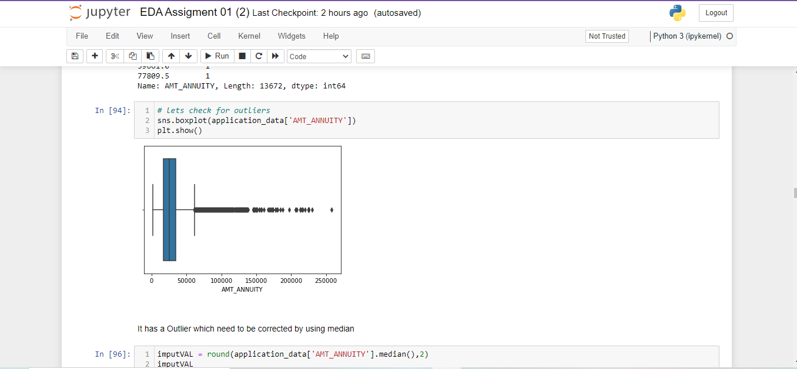
Data Analysis
Finding Outliers through Graphs
Droping unwanted values
Modifying different rows to make it operational.

Slide 6
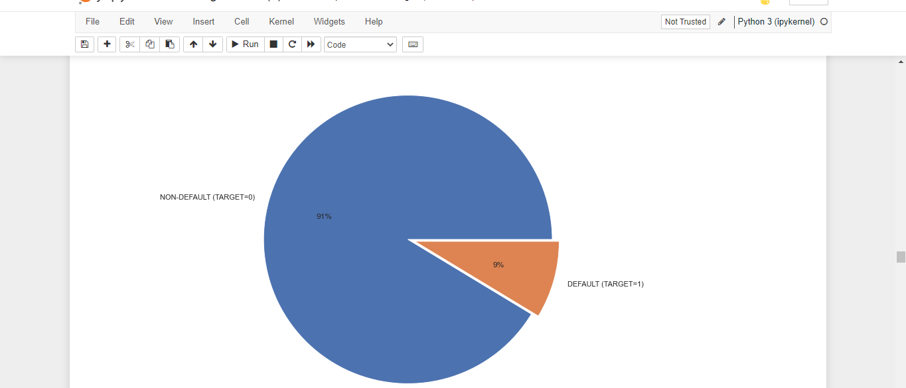
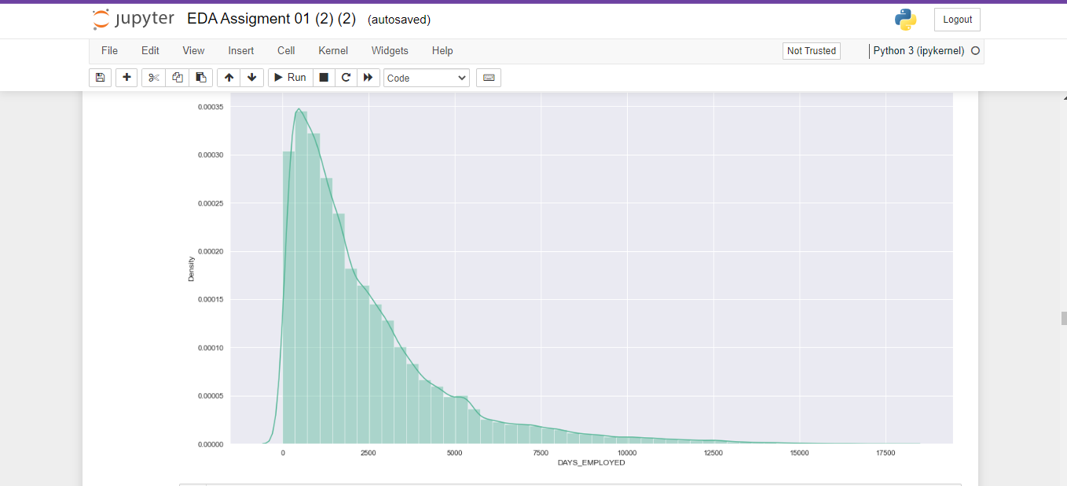
Data Understanding for Analysis
Univariate and Bivariate
Univariate analysis looks at one variable
And Multi variate

Slide 7
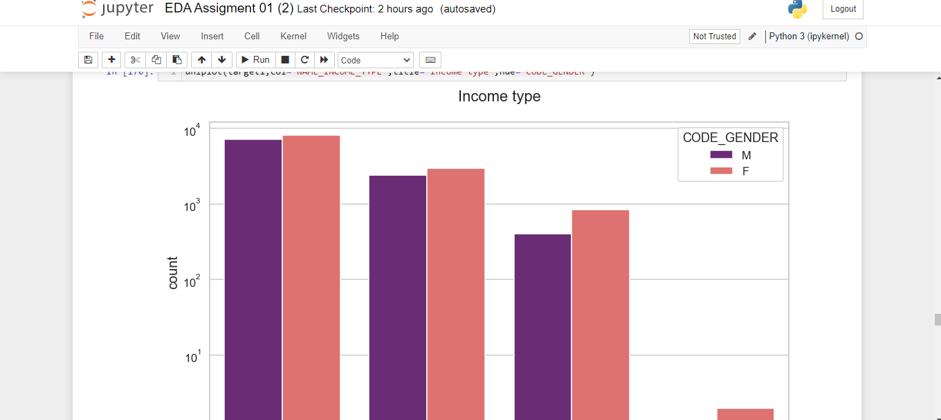
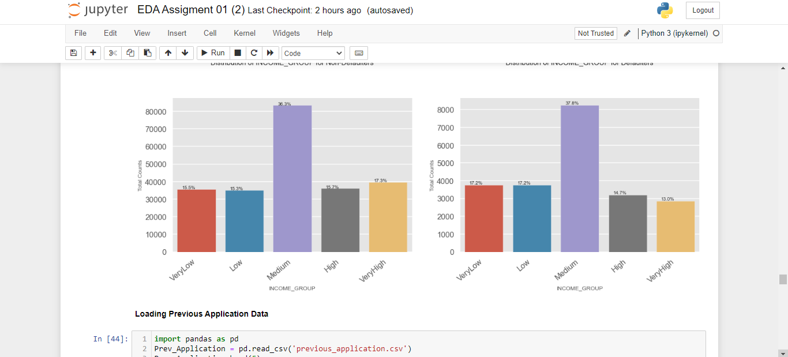
Data Analysis
We need to know the condition income type
Then also need to find the relation

Slide 8
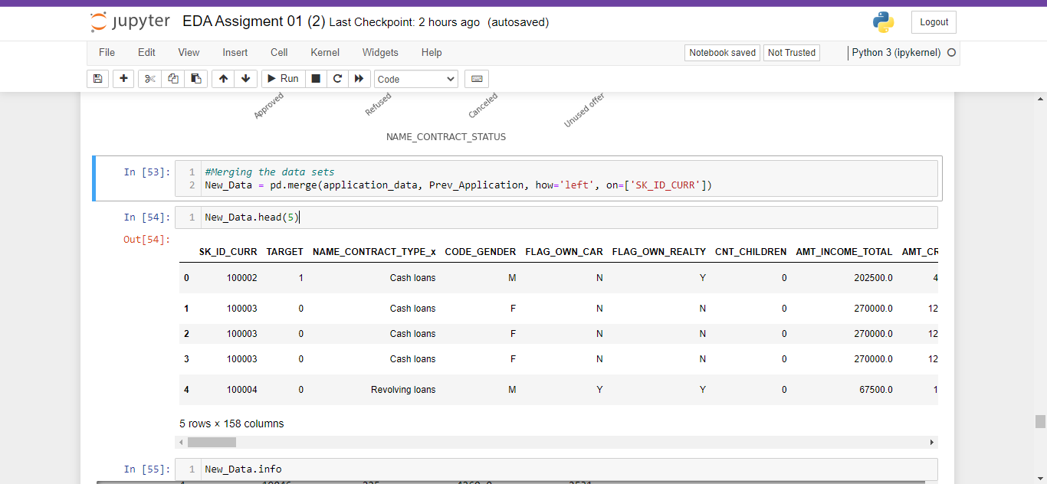
Data Merge
After analysing all the data we can perform the merge operation
After joining then only we can develop the relation between in order to analyse fur.ther

Slide 9
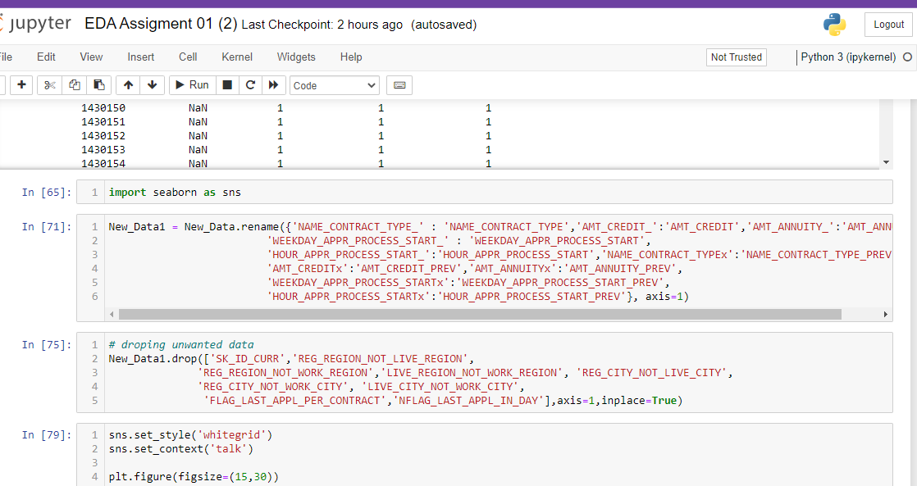
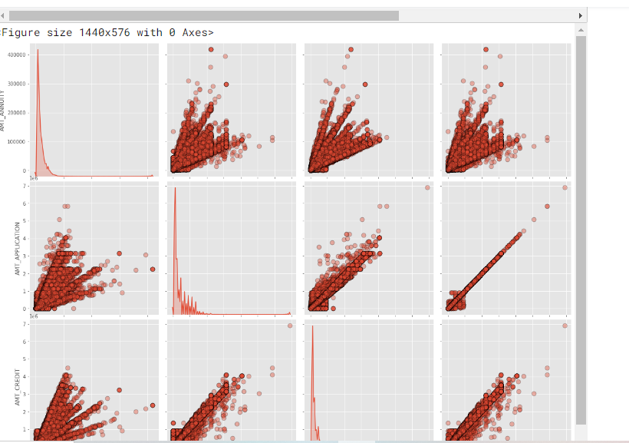
Univariate Analysis
Some more analysis is needed to understand as we know after merge there are few departments having high defaulter who failed in repayment
Data cleaning will still the first approach for second data set as it is possible that previous data can have some errors

Slide 10
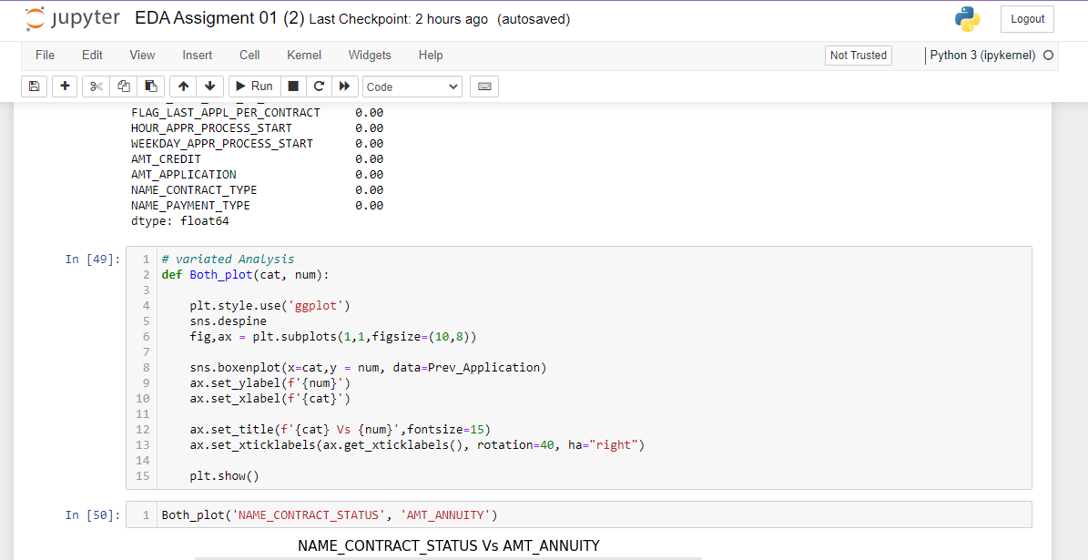
Variate analysis on Previous data set

Slide 11
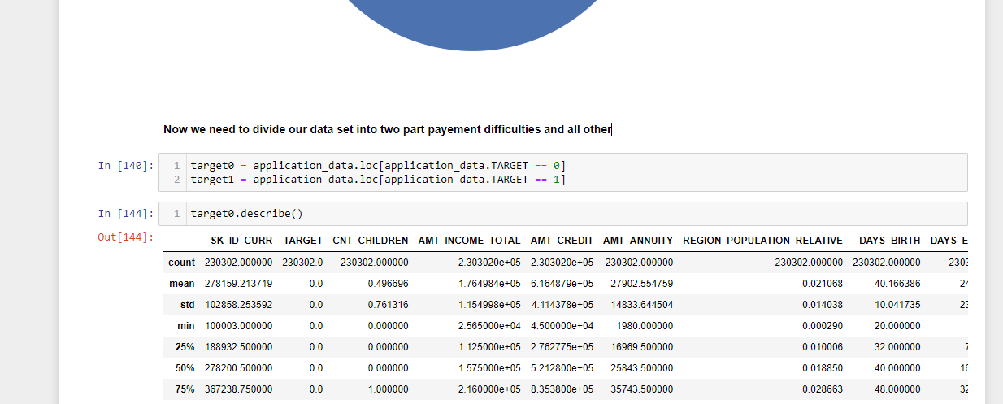
Data Merge Analysis
Try perform corelation on both data set in order to get the extact understanding and used different Graphs to understand the data impurities.
Also Divided data set into two parts first so that we can perform different analysis simultaneously like univariate, multivariate

Slide 12
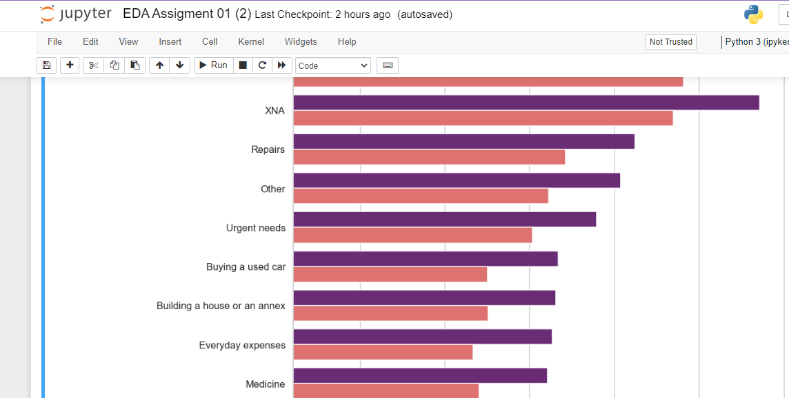
Result Part compare to Business requirements

Slide 13
Conclusion Part
Univariate analysis looks at one variable
Banks Should consider and take care of loan request made by unemployed like Student loan and form average sector like small Business Sector
Education Type has many difficulties in loan repayment.
Default list is also greater for Repair group.

Slide 14
Assumptions on basis of Results
We can see that the people who were approved for a loan earlier, defaulted less often where as people who were refused a loan earlier have higher chances of defaulting.
We see that code gender doesn't have any effect on application approval or rejection.
But we saw earlier that female have lesser chances of default compared to males. The bank can add more weightage to female while approving a loan amount

Slide 15
THE END
Thank You

